Slide 1
SB 850: Homeless Emergency Aid Program (HEAP)
Norther California homeless roundtable
August 23, 2018

Slide 2
Agenda
SB 850 Overview
HCFC Team Members
HEAP Grant Overview
Available Funding
Eligibility Criteria
Eligible Uses
Expenditure Deadlines
Program Timeline
Application Timeline
Application Process
Technical Assistance
Contact Information
https://www.bcsh.ca.gov/hcfc/

Slide 3
SB 850 Overview
Moves the Homeless Coordinating and Financing Council (HCFC) from Department of Housing and Community Development (HCD) to the Business, Consumer Services and Housing Agency (BCSH).
Designates the Secretary of BCSH as Chair of the HCFC.
Adds representative to the HCFC from the Department of Transportation and a formerly homeless youth who lives in California.
Provides permanent staff under BCSH to support HCFC mandates
Establishes the Homeless Emergency Aid Program (HEAP) for purposes of providing localities with one-time flexible block grant funds to address their immediate homelessness challenges.
https://www.bcsh.ca.gov/hcfc/

Slide 4
HCFC Team Members
Position | Staff
Executive Director | Ginny Puddefoot
Research and Policy Specialist | Kelly Joy
Council Specialist | Natalie Nguyen
HEAP Grant Manager | Daniel Castillo
Local Government Liaison | Lahela Mattox
Data Systems Development Project Manager | TBD
https://www.bcsh.ca.gov/hcfc/

Slide 5
HEAP Grant Overview
HEAP is a $500 million block grant program designed to provide direct assistance to cities, counties and Continuums of Care to address the homelessness crisis throughout California.
Designed to provide immediate, one-time, flexible funding.
Provides support until additional resources are available (i.e. SB 2, No Place Like Home, SB 3).
Released over 2, possibly 3, rounds.
Funds not expended in Round 1 will be reallocated for all eligible applicants to apply for again in Round 2.
Allocation of funds not expended in Round 2 is TBD.
https://www.bcsh.ca.gov/hcfc/

Slide 6
Available Funding
Category for Distribution | Funded Amount | Eligible Applicants
Continuum of Care – Based on Point in Time Count Ranges [SB 850: Section 2, Chapter 5, 50213 (a)] | $250M | Continuum of Care (COC)
Continuum of Care – Based on Percentage of Homeless Population [SB 850: Section 2, Chapter 5, 50213 (b)] | $100M | Continuum of Care (COC)
City / City that is also a County – Based on general population [SB 850: Section2, Chapter 5, 50213 (c)] | $150M | Large Cities (LCs) with a population over 330,000
https://www.bcsh.ca.gov/hcfc/

Slide 7
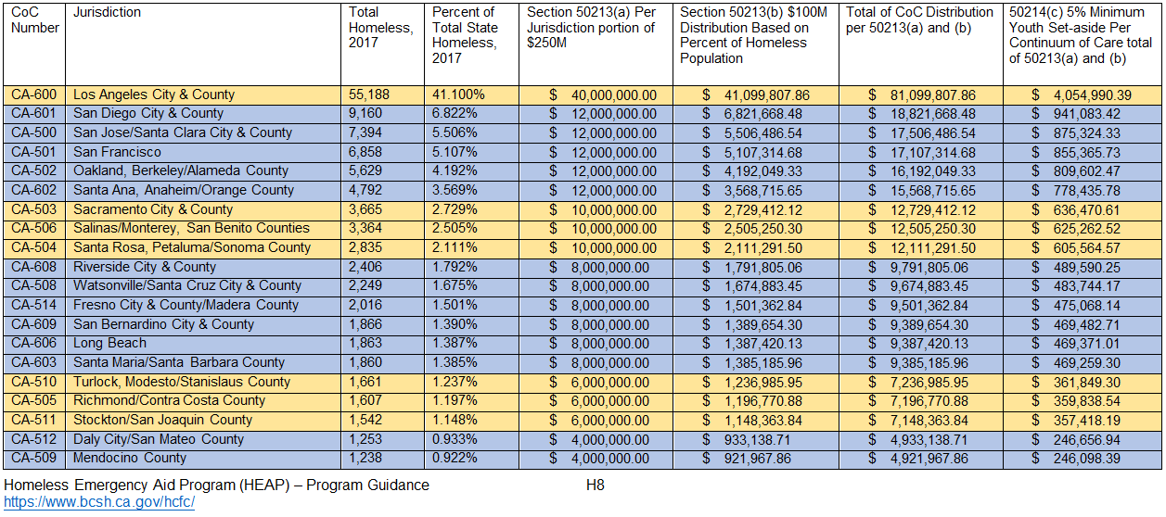
Available Funding (continued)
Continuum of Care 50213 (a) and 50213 (b)
https://www.bcsh.ca.gov/hcfc/

Slide 8
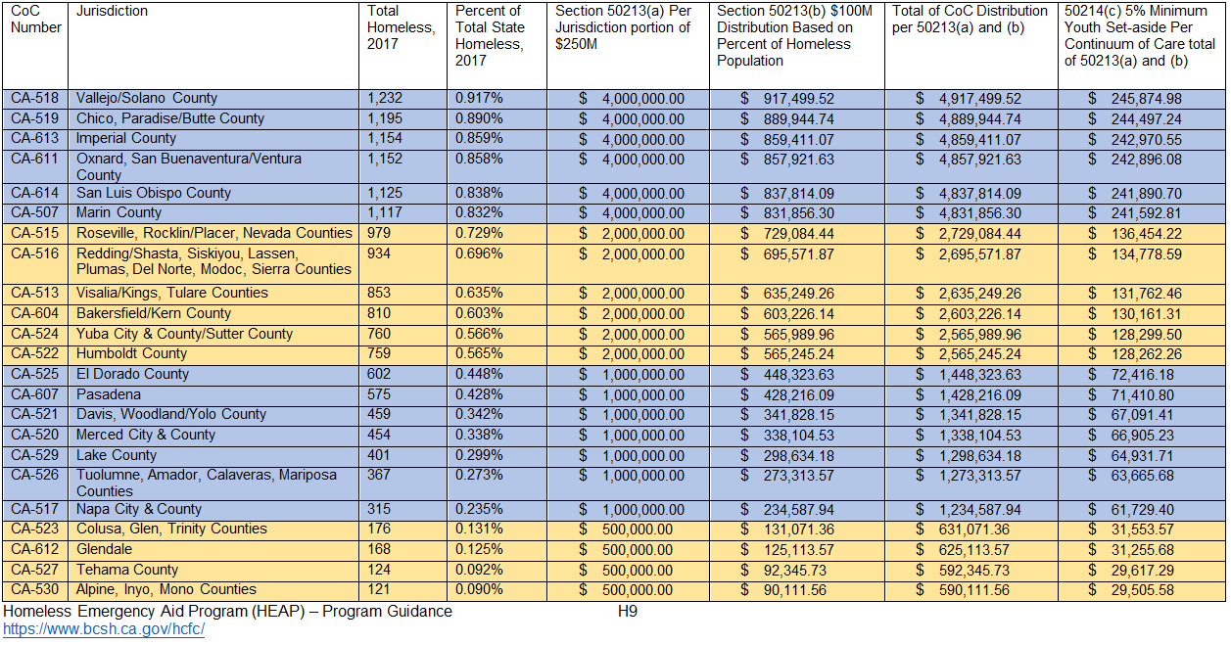
Available Funding (continued)
https://www.bcsh.ca.gov/hcfc/

Slide 9
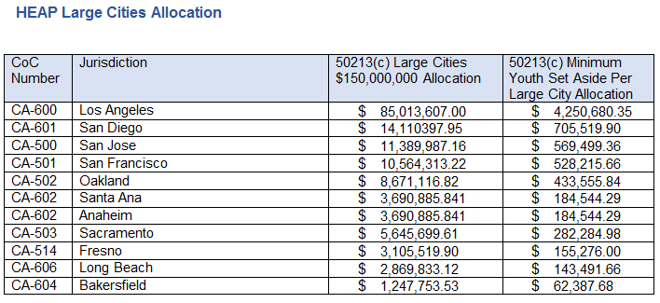
Available Funding (continued)
https://www.bcsh.ca.gov/hcfc/

Slide 10
Eligibility Criteria
A shelter declaration is required for all cities and counties within a CoC that wish to receive HEAP funds, except for CoCs with fewer than 1,000 homeless people, based on the 2017 Point in Time count.
Chapter 7.8 A (commencing with Section 8698) of Division 1 of Title 2 of the Government Code
Counties may declare a shelter crisis only for the unincorporated areas of the county
A CoC with fewer than 1,000 homeless people may submit a waiver with their application
The declaration is a resolution that must be adopted by the governing body of a jurisdiction or jurisdictions within a CoC or LC.
https://www.bcsh.ca.gov/hcfc/

Slide 11
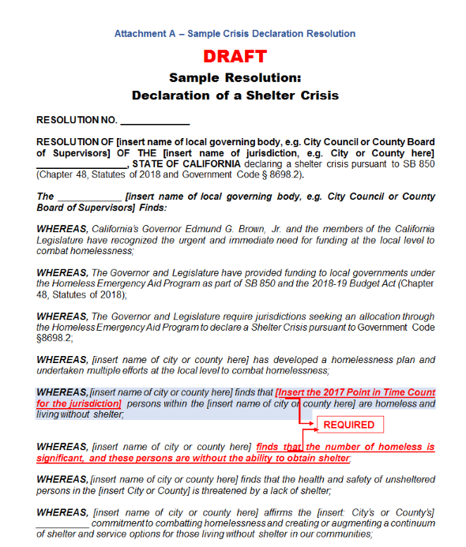
Declaration Sample

Slide 12
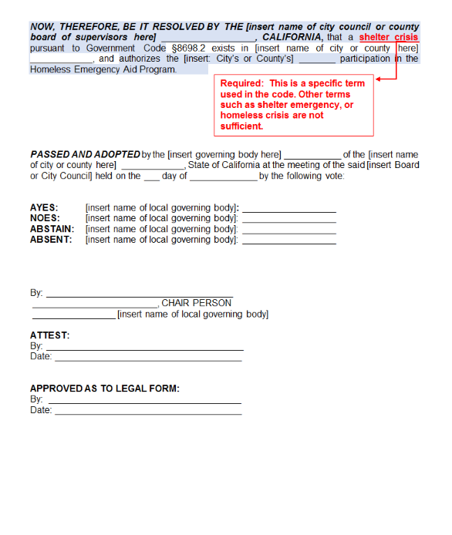
Declaration Sample (continued)

Slide 13
Eligibility Criteria (continued)
Cities that have NOT declared a shelter crisis MAY NOT be the direct recipient of any HEAP funding.
The county may declare a shelter crisis for the unincorporated areas of the county and IS allowed to expend HEAP funding for county activities that serve all county residents.
CoCs, counties and nonprofit organizations MAY NOT use HEAP funds for capital projects, such as building or expanding a shelter or navigation center, within a city(cities) that has/have not declared a shelter crisis.
https://www.bcsh.ca.gov/hcfc/

Slide 14
Eligibility Criteria (continued)
CoCs and Large Cities must demonstrate that a local collaborative process has been conducted prior to application submission.
A collaborative process may include, but is not limited to,
A public meeting
Regional homeless taskforce meeting
Letters of support with signatures of endorsement
An adopted homeless plan
An adopted budget which includes HEAP funds
Proof of a public process may include, but is not limited to,
Sign-in sheets
Meeting minutes
Agendas
Public Comment logs
https://www.bcsh.ca.gov/hcfc/

Slide 15
Eligible Uses
To provide immediate emergency assistance to people experiencing homelessness.
Eligible uses include, but are not limited to,
Homelessness prevention activities,
Criminal justice diversion programs for homeless individuals with mental health needs,
Establishing or expanding services meeting the needs of homeless youth or youth at risk of homelessness,
Emergency aid
The parameters of the program are intentionally broad to allow local communities to be creative and craft programs that meet the specific needs they have identified.
https://www.bcsh.ca.gov/hcfc/

Slide 16
Expenditure Deadlines
50 percent of the awarded funds must be contractually obligated by January 1, 2020.
100 percent of the funds must be expended by June 30, 2021
Unexpended funds must be returned to BCSH
Administrative costs are capped at 5 percent of program funds, but this does not include staff costs directly related to carrying out program activities.
https://www.bcsh.ca.gov/hcfc/

Slide 17
Program Timeline
Information will be circulated to the listserv and posted to HCFC website. To subscribe to listserv: https://www.bcsh.ca.gov/hcfc/
Key Program Information and Documents | Scheduled Release Date
Program Guidance, Timeline, Sample Shelter Crisis Resolution, Funding Allocations | August 3, 2018
HEAP Frequently Asked Questions | August 10, 2018-Ongoing
Application Map | August 17, 2018
Application Instructions | August 17, 2018
Workshops / Webinars – Application Training Documents | August 13, 2018 – Ongoing
https://www.bcsh.ca.gov/hcfc/

Slide 18
Application Timeline
Applications will be reviewed and processed as they are received.
Encourage early applications.
Round 1
NOFA Release | Sep 5, 2018
Early Applications Received | Starting Sep 2018
Early Applications Awarded | Starting Sep 2018
Early Distribution of Funds Begins | Starting in late Oct 2018
Round 1 Application Cut-off Date | Dec 31, 2018
Standard Applications Awarded | Jan 2019
Standard Distribution of Funds Begins | Apr 2019
Round 2
NOFA Release | Feb 15, 2019
Early Applications Received | Starting Feb 2019
Early Applications Awarded | Starting Feb 2019
Early Distribution of Funds Begins | Starting in late Mar 2019
Round 1 Application Cut-off Date | Apr 31, 2019
Standard Applications Awarded | May 2019
Standard Distribution of Funds Begins | July 2019
https://www.bcsh.ca.gov/hcfc/

Slide 19
Application Process
Streamlined process designed to quickly and efficiently award and distribute funds.
Online process to support accuracy and streamline review and reporting.
Preparation:
Application map with instructions released August 17, 2018. Includes content and attachment requirements that will be in the application.
A sample City/County Resolution has been provided in the HEAP Program Guidance document released August 3, 2018.
Definitions and examples of Collaboration included in HEAP Program Guidance document released August 3, 2018.
Webinars, training materials and technical assistance will be provided.
https://www.bcsh.ca.gov/hcfc/

Slide 20
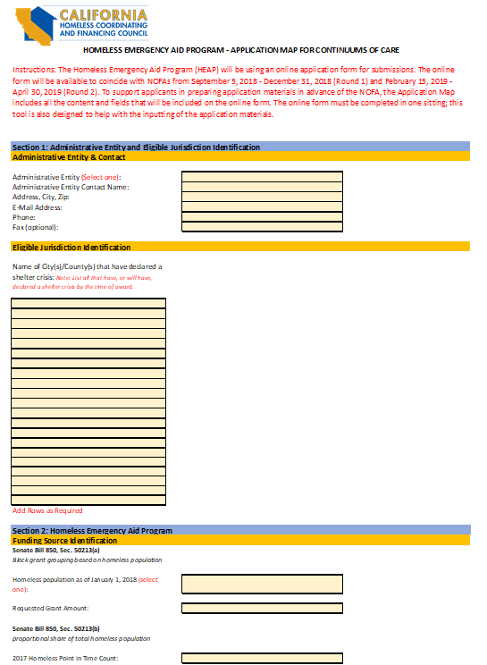
Application Map

Slide 21
Application Process (Continued)
Application Submission:
Online portal will open to coincide with NOFA rounds.
Application must be submitted in one sitting – Application Map should be used to collect information in advance.
Errors or missing information will flag for the applicant; must be corrected and completed before submission is complete.
Applicant will receive a confirmation email; Reply to email with required attachments
Requesting administrative forms as part of the application to expedite the fund distribution
Application Review and Award:
HCFC Staff will review the application with the goal of rapid award
Award Letter and BCSH-signed contract will be issued simultaneously
Request for counter-signature and Request for Funds Form (RFF) within 45 days of receiving award
Upon receipt of signed contract and RFF HCFC will process disbursement
https://www.bcsh.ca.gov/hcfc/

Slide 22
Technical Assistance
HCFC will provide ongoing technical assistance and training to support CoCs and LCs.
Housing and Community Development (HCD) and HCFC have scheduled workshops to provide information (see schedule).
HCFC will schedule additional workshops and webinars
https://www.bcsh.ca.gov/hcfc/

Slide 23
HCD Workshop Schedule
CITY | DATE | LOCATION | TIME | Registration
Sacramento | August 24 | CA Department of Housing and Community Development Room 402 2020 W El Camino Ave, Sacramento, CA 95833 | 10:00 am-4:30 pm | In person registration Track 1: NPLH 10:00 am-4:30 pm Meeting number: 731 023 870 Meeting password: NPLH1 Join the webinar Audio Only: (877) 873-8018 Access code: 9035096 Track 2: CESH/HEAP 10:00 am-4:30 pm Software download Join the webinar Audio Only: (877) 336-1829 Access code: 2636575
Oakland | August 30 | Elihu Harris Building Room 1 1515 Clay St Oakland, CA 94612 | 10:00 am-4:30 pm | In person registration
Visalia | September 7 | Tulare County Office of Education Redwood EF 6200 S Mooney Blvd Visalia, CA 93277 | 10:00 am-4:30 pm | In person registration
Riverside | September 10 | California Tower Room 200 3737 Main St Riverside, CA 92501 | 10:00 am-4:30 pm | In person registration
https://www.bcsh.ca.gov/hcfc/

Slide 24
Contact Information
Additional information regarding the HEAP program is available on the HCFC website. https://www.bcsh.ca.gov/hcfc/
To receive information releases regarding the HEAP program, please register for the program listserv
If you have questions, please direct them to the HCFC inbox at HCFC@BCSH.ca.gov
Social media
https://twitter.com/CA_HCFC
https://www.facebook.com/CalHCFC/
https://www.bcsh.ca.gov/hcfc/

Slide 25
QUESTIONS?
https://www.bcsh.ca.gov/hcfc/

